Slide 1
中国海关跨境电商统计试点 Pilot Program on CBEC by GACC
“国际贸易统计和经济统计的综合应用”国际培训班
International Workshop on the Integrated Use of International Trade Statistics and Economic Statistics
2021-11-24

Slide 2
主要内容
Outline
利用行政记录开展跨境电商管理平台统计（2014~）Stats via Identifying CBEC Records among Customs Declarations
开展跨境电商全业态统计调查（2016~）
Stats via Survey for CBEC in a broad sense
中国海关跨境电子商务统计的范围
Scope of CBEC Stats by GACC

Slide 3
中国海关统计是中国对外货物贸易的官方统计
China Customs Statistics in the official statistics of the external merchandise statistics of the People’s Republic of China.
自1980年起海关全面采用联合国统计标准
ITS/IMTS has been fully adopted in Customs Statistics since 1980.
实际进出境并改变境内物质存量的货物及超出个人合理数量的物品列入海关统计
All goods which add to or subtract from the stock of material resources of China by entering (imports) or leaving (exports) its customs territory.
中国海关
China Customs
监管
Customs Control
统计
Statistics
其他
Other
缉私
Anti-smuggling
征税
Duty Collection

Slide 4
跨境电商货物定义/应当列入进出口统计/数据采集困难
· Definitions of goods in electronic Commerce · Inclusion· Challenges in data collection
跨境电商货物特点/主要2C但同样2B/测度的原则
· Characteristics of CBEC · Mainly 2C while 2B · Mechanism of Measurement
数字订购贸易定义/测度方法/挑战
· Definition of digitally ordered trade· Measuring approach· Mechanism of Measurement

Slide 5
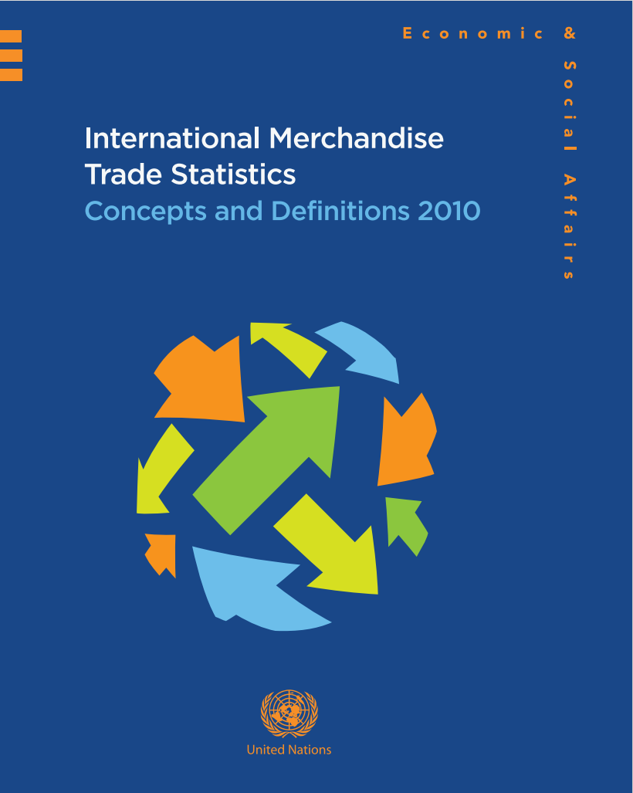
1.34. 电子商务货物。“电子商务货物”一词指由于交易完全或在很大程 度上靠电子手段进行而实际越过国界的货物（例如，经由因特网订购和支付的货物）。这类货物属于《2010年国际商品贸易统计：概念和定义》规定的出口和进口范围。应当承认进行该项目下的数据收集可能具有挑战性（例如，在通过邮包、邮件或快递服务运送货物时，详情和建议见上文第1.25段）。鼓励各国从长远角度制定必要的数据收集和/或评估程序
1.34. Goods in electronic commerce
. The term “goods in electronic commerce” refers to goods that physically move across country borders as the result of transactions executed entirely, or to a significant extent, by electronic means (e.g., goods ordered and paid for via the Internet). Such goods are in the scope of IMTS 2010 for both exports and imports. It is recognized that data collection under this item may be challenging (for example, when goods are shipped through parcel or letter post
or courier service; see para. 1.25 above for details and recommendations); however, countries are encouraged to develop over time the necessary data-collection and/or estimation procedures.

Slide 6
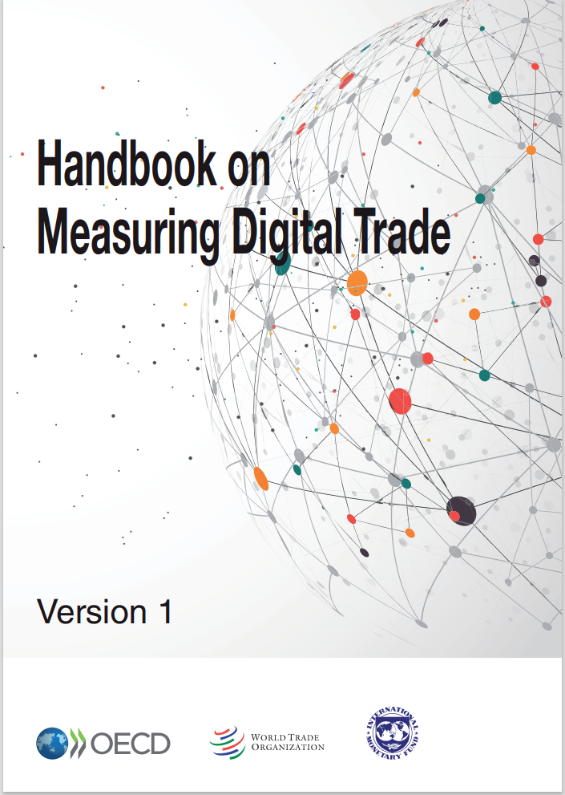
跨境电子商务的特点： • 在线下订单、销售、沟通磋商以及部分情况下支付 •跨境交易、运输• 有形实物 • 交付消费者、买方（商业及非商业）。本框架主要适用于B2C及C2C，鼓励成员方将相同原则及标准适用于B2B交易。
Characteristics of Cross-Border E-Commerce • Online ordering, sale, communication and, if applicable, payment, • Cross-border transactions/shipments, • Physical (tangible) goods, and • Destined to consumer/buyer (commercial and non-commercial). This Framework sets standards mainly for B2C and C2C transactions. However, Members are encouraged to apply the same principles and standards to Business-to-Business (B2B) transactions.
测度的原则：跨部门合作，符合国际统计标准与国内政策
Mechanism of Measurement
Customs administrations should work with relevant government agencies in close cooperation with E-Commerce stakeholders to accurately capture, measure, analyse and publish cross-border E-Commerce statistics in accordance with international statistical standards and national policy, for informed decision making.

Slide 7
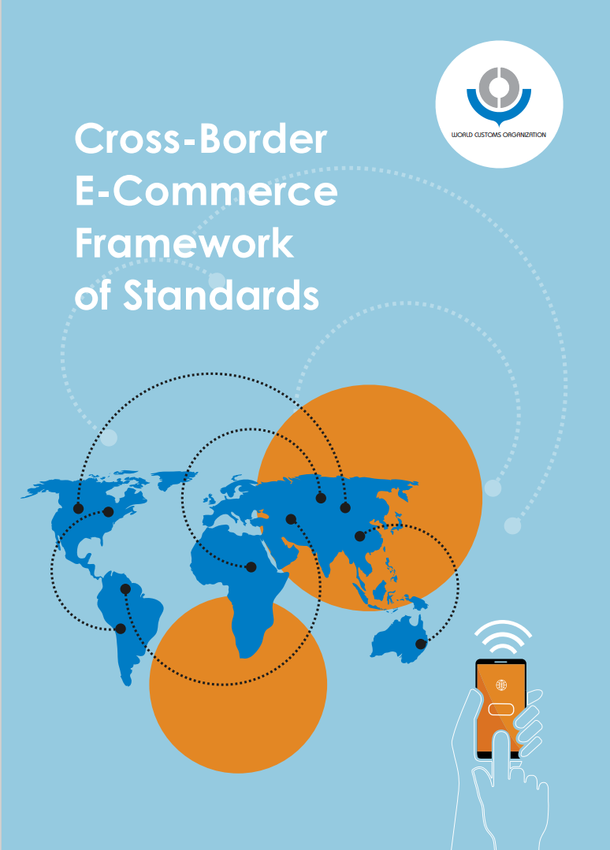
数字订购贸易：与OECD电子商务定义一致，即在专门设计用于在线下达或接收订单的电子计算机网络平台上进行的货物或服务的国际采购。支付与交付不一定在线，不包括电话、传真或电子邮件达成的交易。
Digitally ordered trade as defined in this Handbook follows the OECD’s definition of e-commerce, and is defined as: “The international sale or purchase of a good or service, conducted over computer networks by methods specifically designed for the purpose of receiving or placing orders”. Some additional clarifications are provided in this definition. Specifically, these state that the payment and ultimate delivery of the goods or services do not also have to be conducted online. Transactions can involve participants from all institutional sectors, and cover orders made over the web1 , extranet or via EDI. Excluded are orders made by phone, fax or manually typed email.

Slide 8
中国海关跨境电商统计定义：跨境电子商务是指所有通过互联网等计算机网络数字化达成，由此产生了有形货物的移动，并需要办理海关手续的交易 。
跨境电子商务符合“跨境”+“改变物质存量”原则，是货物贸易统计的一部分。
在线订单Digitally Ordered
跨境物流Cross-Border
统计口径Scope
有形实物Physical Products

Slide 9
从海关行政记录中采集跨境电商统计原始资料
Identifying Sources for CBEC Stats from Customs Declarations
2017年9月，联合国统计司苏州培训班，中国海关介绍跨境电商统计进展
Regional Workshop on International Merchandise Trade Statistics（ Suzhou, China 11-13 September, 2017）
Regional Workshop on International Merchandise Trade Statistics - United Nations Statistics Division

Slide 10
从海关行政记录中采集跨境电商统计原始资料
Identifying Sources for CBEC Stats from Customs Declarations
2014年以来，海关总署不断增设跨境电商专用监管方式
Specific Customs Procedures have been introduced since 2014.
跨境直购9610
2014年12号公告增列Customs Announcement No12,2014
网购保税1210
2014年57号公告增列Customs Announcement No57,2014
网购保税A1239
2016年75号公告增列Customs Announcement No75,2016
B2C
进口及出口IM&EX
B2B2C
进口为主，少量出口Mostly IM
B2B2C
进口(非试点地区)IM
B2B出口9710
2020年75号公告增列Customs Announcement No75,2020
B2B
出口(非海外仓)EX
海外仓出口9810
2020年75号公告增列Customs Announcement No75,2020
B2B
出口(海外仓)EX

Slide 11
从海关行政记录中采集跨境电商统计原始资料
Identifying Sources for CBEC Stats from Customs Declarations
9610
B2C
9710
9810
B2B
1210
B2C
1210
B2B
1239
B2B
关境
Border
1210
B2B
1210
B2C
1239
B2C
关境/Border
特殊监管区域/保税物流中心
Bonded Warehouses/zones
贸易统计/Trade Statistics
单项统计/Separate Statistics

Slide 12
从海关行政记录中采集跨境电商统计原始资料
Identifying Sources for CBEC Stats from Customs Declarations
2016年以来，海关总署增加跨境电商专用通关系统，促进通关便利化
Specific Customs Clearance Systems have been introduced since 2018.
H2018系统Customs Clearance System
普通货物Normal goods
进出口货物报关单Declarations for normal goods
快件通关系统Customs Clearance System for Express Deliveries
快件ABC类Express letters and parcels
快件报关单Declarations for express goods
邮件通关系统Customs Clearance System for Posts
邮政运营的信函包裹快件Postal letters and parcels
邮政专用单据Declarations for postal parcels
跨境电商进出口系统Customs Clearance for CBEC goods
跨境电商货物CBEC goods
跨境电商清单Simplified declarations for CBEC goods

Slide 13
跨境电商统计
CBEC Stats
进口统计
IM Stats
H2018通关系统1210/1239
H2018 Clearance System for normal goods B2B2C/B2C
跨境电商统一版系统9610汇总统计
CBEC Clearance System B2C
By aggregation
出口统计
EX Stats
H2018通关系统9610/9710/9810
H2018 Clearance System for normal goods B2C consolidation filing
跨境电商统一版系统9610/9710/9810汇总统计
CBEC Clearance System B2C
By aggregation
跨境电商统一版系统1210汇总统计
CBEC Clearance System B2B2C
By aggregation
采集9610等行政记录编制跨境电商统计
Stats by declarations with specific customs procedure code like 9610

Slide 14
从海关行政记录中采集跨境电商统计原始资料
Identifying Sources for CBEC Stats from Customs Declarations
中国进出口货物贸易统计Stats of trade in goods
中国跨境电子商务管理平台统计Stats of CBEC with specific Customs procedures
2017年中国跨境电商管理平台进出口900亿元。
CBEC volume of 2017 reached RMB90 billion.

Slide 15
通过识别特定监管方式数据是否全面统计跨境电商？
Has every flow of CBEC goods been captured by collecting specific customs records?
跨境电商进出口与全国进出口增速比较
Comparison of the Percentage change between CBEC and Total Trade
年份 YEAR | 电商% CBEC% | 全国% Total Trade%
2014 | - | 2.3
2015 | 818.0 | -7.0
2016 | 38.7 | -0.9
2017 | 80.6 | 14.3
2018 | 49.3 | 9.7

Slide 16
采集海关行政记录之外的信息编制跨境电商全业态统计
Going beyond Customs declarations for CBEC in a broad sense
平台platforms
卖家on-line vendors
境外
Abroad
平台platforms
境内
Domestic
物流服务商 logistics providers
支付服务商 payment companies
买家on-line buyers
卖家on-line vendors
物流服务商 logistics providers
支付服务商 payment companies
买家on-line buyers

Slide 17
采集海关行政记录之外的信息编制跨境电商全业态统计
Going beyond Customs Declarations for CBEC
调研访谈主要结果Main findings of Interviews：
海关跨境电商统计口径受到业界认可
Scope of CBEC is widely accepted.
卖家与买家等选择最合适自身需要的通关方式，往往不一定采用跨境电商海关监管方式
CBEC Customs procedures like 9610 is only one choice for vendors or buyers.
支付企业不能提供具体跨境电商结算规模，但可以提供佣金等有效信息
Payment companies are not able to provide volume of CBEC, while their commission info is helpful.
按照个人物品监管的进出境邮快件包裹中也存在电商货物，未列入海关统计
CBEC goods as Express deliveries and postal parcels destined for individual buyers are missed in trade statistics.

Slide 18
采集海关行政记录之外的信息编制跨境电商全业态统计
Going beyond Customs Declarations for CBEC
境内平台Domestic Platforms
调研访谈Interview
调查问卷Survey
境内卖家Domestic Vendors
调研访谈Interview
境内物流商Domestic Logistics Providers
调研访谈Interview
调查问卷Survey
调查问卷Survey
境外平台Platforms abroad
公开财务数据
Financial Report
其他境内机构Other Domestic Agencies
调研访谈Interview
原始资料Sources
验证资料
Info for verification
验证资料
Info for verification
辅助资料
Info for compilation
原始资料Sources

Slide 19
采集海关行政记录之外的信息编制跨境电商全业态统计
Going beyond Customs Declarations for CBEC
2016-2018
调研访谈Interviews
重点调查与编制试点Annual Survey and Compilation
2019-2020
完善调查问卷与编制方法Improved Survey
2021~
公布初步数据Preliminary Stats Released
实现邮快件电商包裹列入统计
提升调查频度Biannual Survey and compilation
继续完善调查问卷Improved Survey

Slide 20
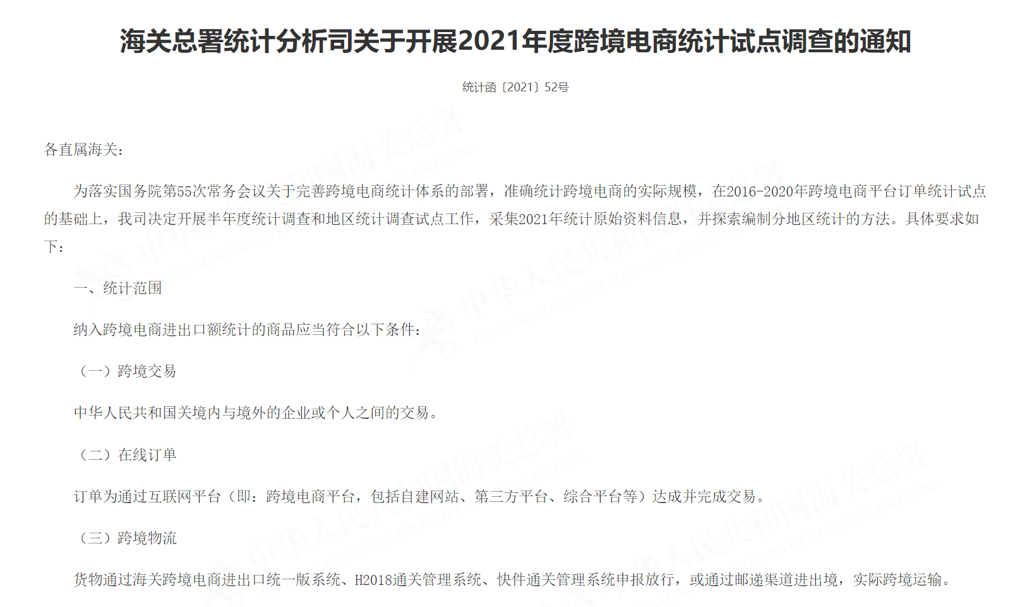
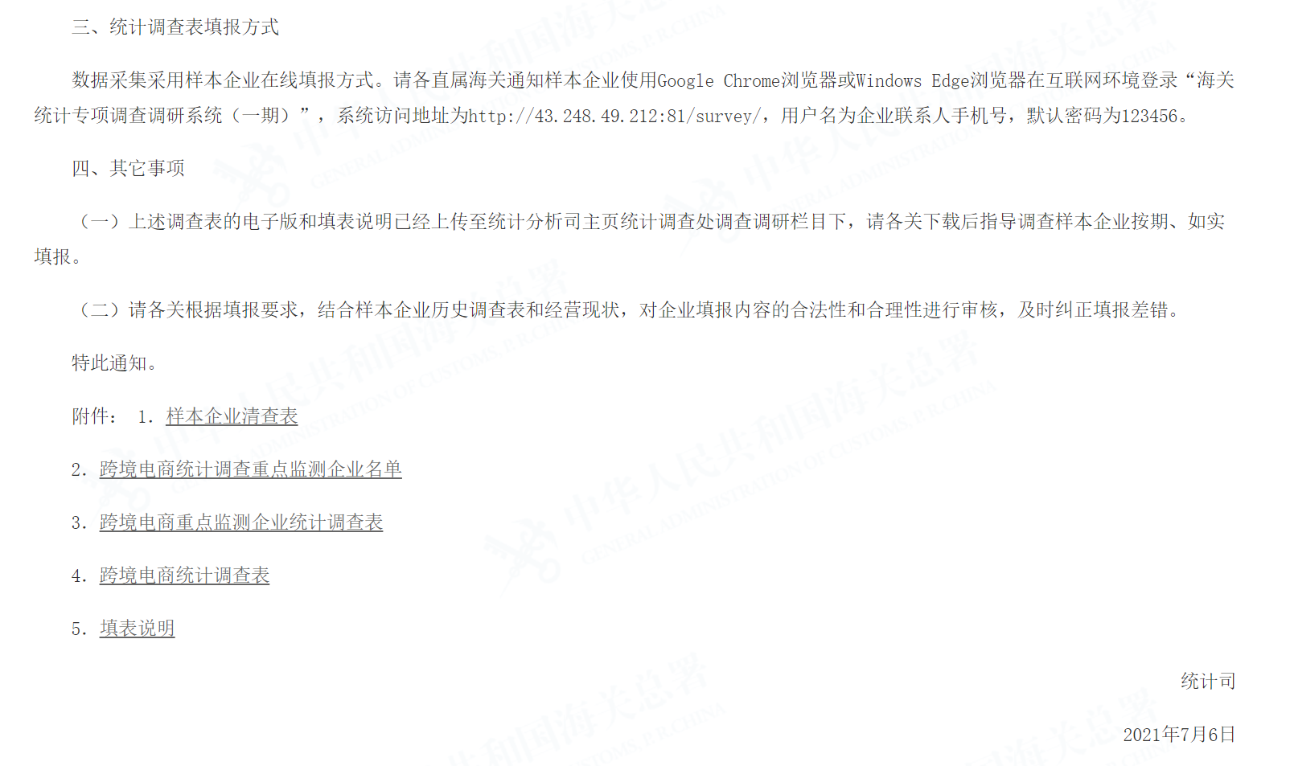
采集海关行政记录之外的信息编制跨境电商全业态统计
Going beyond Customs Declarations for CBEC
http://www.customs.gov.cn//customs/302249/zfxxgk/zfxxgkml34/3756878/index.html

Slide 21
2-1 出口表For export
业务类型 | Type of business(platform/vendor/logistics and other)
平台名称 | (name of platform where placed orders)
平台网址 | (address of platform where placed orders)
2 出口额（万元人民币）Value of total export |  |  |  | 0
2.1 按出境渠道 By exporting modes | 2.1.1 经海关跨境电商管理平台出口额（万元人民币）by CBEC Customs Procedures |  |  | 0
 | 2.1.2 未经海关跨境电商管理平台出口额（万元人民币）not by CBEC Procedures |  |  | 0
 |  | 2.1.2.1 自主出口额（万元人民币）as exporter |  | 0
 |  |  | 2.1.2.1.1 经普通货物渠道出口额（万元人民币）by HS2018 | 0
 |  |  | 2.1.2.1.2 经邮快件渠道出口额（万元人民币）by Express or Posts | 0
 |  | 2.1.2.2 非自主出口额（万元人民币）not as exporter |  | 0
2.2 按境外销售类型 By modes of sales abroad | 2.2.1 在境外自营平台销售出口额（万元人民币）by self-run platforms |  |  | 0
 | 2.2.2 在境外第三方平台销售出口额（万元人民币）by other platforms |  |  | 0
2.3 按目的国/地区 By destinations | 前5位top 5 |  | 主要目的国/地区destinations | 占比%
 | 2.3.1 |  |  | 0
 | 2.3.2 |  |  | 0
 | 2.3.3 |  |  | 0
 | 2.3.4 |  |  | 0
 | 2.3.5 |  |  | 0
2.4 按境内货源地 By domestic locations | 前5位top 5 |  | 主要境内货源地domestic locations | 占比%
 | 2.4.1 |  |  | 0
 | 2.4.2 |  |  | 0
 | 2.4.3 |  |  | 0
 | 2.4.4 |  |  | 0
 | 2.4.5 |  |  | 0
2.5 按商品品类 By type of goods | 2.5.1 消费品出口额（万元人民币）consumption goods |  |  | 0
 | 前3位top3 |  | 主要品类类别 | 占比%
 | 2.5.1.1 |  |  | 0
 | 2.5.1.2 |  |  | 0
 | 2.5.1.3 |  |  | 0
 | 2.5.2 生产资料出口额（万元人民币）non-consumption goods |  |  | 0
 | 序号 |  | 品类类别 | 占比%
 | 2.5.2.1 |  | 初级产品primary products | 0
 | 2.5.2.2 |  | 工业中间品intermediates | 0
 | 2.5.2.3 |  | 资本品capital | 0
跨境电商调查问卷样例（出口）
Sample of Survey Questionnaire for CBEC Stats（EX）
对调查问卷进行交叉复核Cross-checked

Slide 22
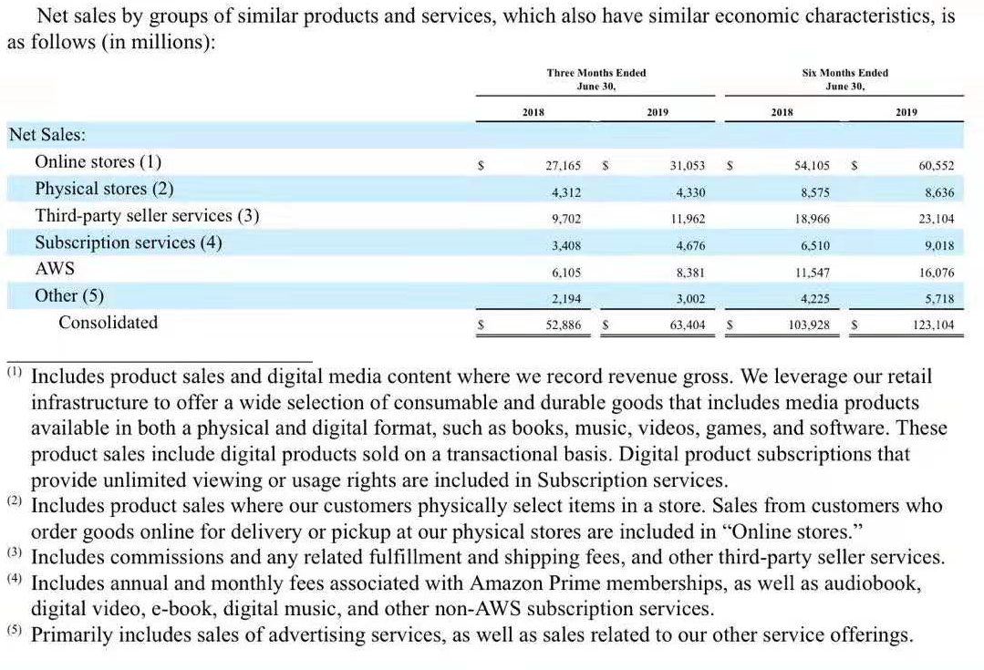
对境外平台财报数据进行统计处理——以亚马逊为例
Processing Data from Financial Report of platform abroad: i.e. Amazon
财报
Financial Report
第三方平台营收Third Party Seller Service
通过佣金等计算第三方交易额Third party sales by commission etc.
价格调整Sales Price-FOB conversion
自营部分
On-line stores
汇率折算USD-RMB conversion
第三方+自营=在线成交额total sales
计算原产中国货物规模Total sales originated in China

Slide 23
采集海关行政记录之外的信息编制跨境电商全业态统计
Going beyond Customs Declarations for CBEC
货物贸易统计Trade Statistics
跨境电商全业态统计CBEC of broad sense
跨境电商管理平台统计CBEC by customs procedure codes

Slide 24
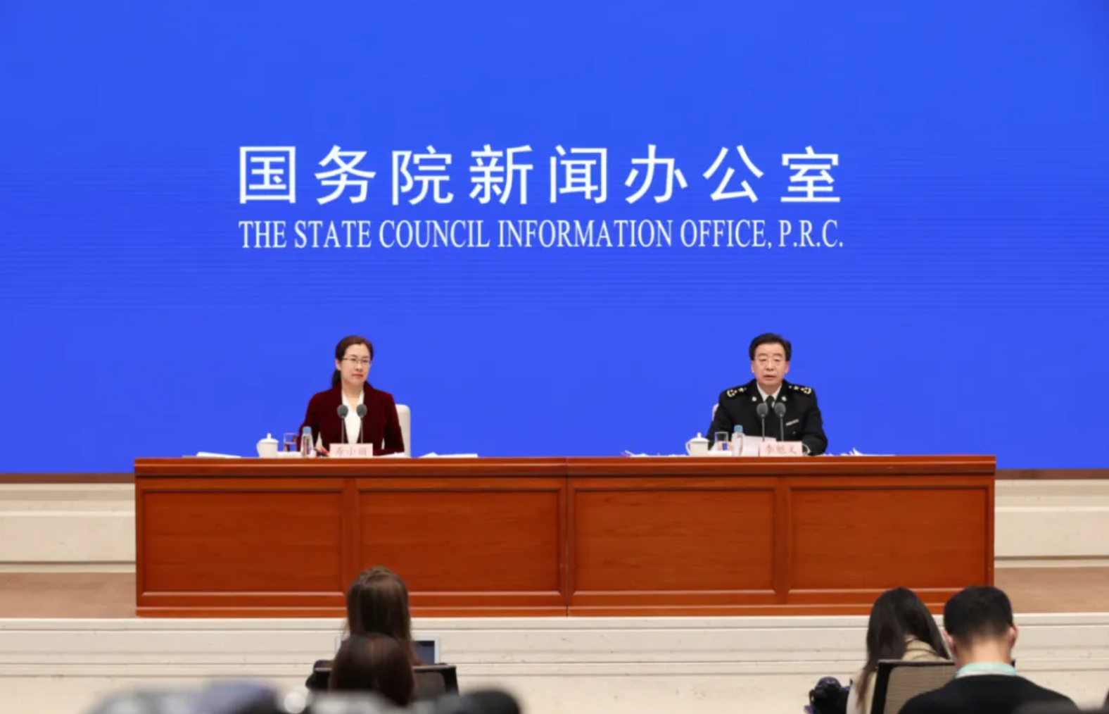
采集海关行政记录之外的信息编制跨境电商全业态统计
Going beyond Customs Declarations for CBEC
海关总署新闻发言人、统计分析司司长李魁文：为全面反映跨境电商整体进出口情况，海关总署充分借鉴我国《电子商务法》以及世界海关组织对跨境电商的定义，探索建立了跨境电商统计体系。据海关初步统计，2020年我国跨境电商进出口1.69万亿元，增长了31.1%，其中出口1.12万亿元，增长40.1%，进口0.57万亿元，增长16.5%。
Mr. Li Kuiwen, Director General of Statistics Department and Spokesman of GACC: China’s CBEC volume of 2020 reached RMB1690 billion, up by 31.1% than the previous year. Exports grew by 40.1% to RMB1120 billion and imports grew by 16.5% to RMB570 billion.
注：上述数据以前期统计调查及消费品进出口数据为基础测算。
The above data was estimated on basis of previous surveys and imports and exports of consumptions.
国务院新闻办2021年1月14日新闻发布会
Press Conference by the State Council Information Office
2021-1-14

Slide 25
评价与建议
Comments & Suggestions
跨境电商全业态统计有助于全面理解跨境电商的业务模式与海关通关模式
CBEC Stats in the broad sense helps understanding CBEC patterns in real world and the customs management.
跨境电商全业态统计的颗粒度、时效性以及国际可比性落后于以行政记录为原始资料编制的海关统计数据
CBEC Stats in the broad sense is not as satisfying as traditional statistics based on customs declarations in terms of detailedness, timeliness and international comparability.
跨境电商全业态统计需要平台等相关方提供更多高质量数据
More qualified sources and information from platforms as well as other relevant CBEC parties are needed for better statistics.
在数字贸易统计的背景下，跨境电子商务统计方法还需要进一步完善
More efforts should be taken to improve the methodology of CBEC Stats in context of Digital Trade Stats.

Slide 26
谢谢大家！
Thank you for your attention！
李芊
liqian@mail.customs.gov.cn
86-10-65195640

